Slide 1

Advancing Health Equity in Health Insurance Marketplaces:
Perceptions of Progress and Challenges
from Stakeholders in Two Leading States
Anna Stelter, MPH, LMSW
Nadia Siddiqui, MPH
Matthew Turner, PhD, MPH
Dennis Andrulis, PhD, MPH
Communities Joined in Action
Annual Conference
February 16, 2017

Slide 2
Overview
Background & Context
  About Texas Health Institute
  Study Origins, Objectives, Design
Results
  California
  Connecticut
ACA uncertainty and the fate of marketplaces?

Slide 3
Background

Slide 4


About Texas Health Institute
Nonprofit, nonpartisan public health research and policy institute based in Austin, Texas
Monitoring national health reform from a health equity lens since 2007 across 5 key areas:
    Health insurance
    Health care safety net
    Health care workforce
    Data & quality
    Public health & prevention
Notes:
Our seminal report from 2010 identified that working to advance health equity is central to the Affordable Care Act (ACA), including its provisions on health insurance marketplaces.

Slide 5



Origin of the Marketplace Health Equity Assessment Tool (M-HEAT)
THI has monitored and reported on health insurance marketplaces nationally from a health equity perspective since their launch in 2013.
Covered California and Access Health CT
are among leading marketplaces monitored over time.
Notes:
Recognition that diverse populations comprise a large proportion (and in some cases a majority) of marketplace eligible especially in states like California
While some states were leading in their focus and efforts to reach and enroll diverse communities, others were far less behind
As early as the first enrollment period, many challenges emerged to reaching and enrolling diverse communities

Slide 6
Marketplaces as “Labs” to Examine Organizational Health Equity
Marketplaces existed before ACA (e.g., www.eHealthInsurance.com) but served those temporarily uninsured and did not connect users w/ financial assistance.
ACA marketplaces created to serve primarily lower & middle income (100-400% FPL) chronically uninsured
People of color made up 75% of remaining uninsured in CA, and 47% of remaining uninsured in CT.
Notes:
ACA marketplaces were established to serve chronically uninsured or underinsured of specific incomes.
100% FPL for family of four is $24,300, 400% FPL for family of four is $97,200
Half to three-fourths of these are people of color.
In many ways, newly established ACA marketplaces represented a bridge service linking culturally and linguistically diverse people who have been chronically underinsured to access to care.
We sought to understand how well this function was reflected in the way they operate, and how those efforts were received in specific communities and populations they served.

Slide 7
M-HEAT Objectives
With support from W.K. Kellogg Foundation, The California Endowment, and Connecticut Health Foundation, THI developed and pilot-tested the Marketplace Health Equity Assessment Tool (M-HEAT) in California and Connecticut:
To take stock of the marketplace’s health equity programs and initiatives
To understand the marketplace’s progress and performance
To provide external, community-based validation of the marketplace’s programs, progress, and performance toward health equity
Notes:
The M-HEAT offers a unique opportunity to systematically monitor and report on how and how well the marketplace is working to extend health care coverage to historically disadvantaged population groups. It helps to elucidate the marketplace’s progress and performance in addressing health equity, diversity, language access, and cultural competency in its structure, process, and outcomes. Furthermore, the tool offers insight on leading efforts and models for application, as well as areas for improvement and advocacy to help better reach and enroll specific population groups.
Marketplaces are not the only organizations that do this – hospitals, public health departments, private insurance companies, etc all contribute. We developed a 360 degree evaluation of marketplaces, understanding they’re not the only piece of the puzzle, and an organizational assessment of health equity piloted in marketplaces could be adapted to suit other pillars of the health system.

Slide 8
M-HEAT Framework
M-HEAT Topics
1. Organizational Commitment to Health Equity: strategic and financial commitment, leadership and staff diversity, organizational policies
2. Plan Management and Health Equity: active purchasing, REL data collection, network adequacy
3. Community Engagement and Collaboration: diverse community stakeholder engagement, tribal consultation, cross-sector collaboration
4. Navigator and In-Person Assistance Program: Scope and reach or NIPA, training and certification, language and interpreter services
5. Marketing and Outreach: Marketing channels, messaging, vetting, website content and use
6. Marketplace Outcomes: Enrollment, renewals, churn, and coverage to care utilization
DEFINITION OF
HEALTH EQUITY
Health equity is the attainment of the highest level of health for all people. Achieving health equity requires valuing everyone equally with focused and ongoing societal efforts to address avoidable inequalities, historical and contemporary injustices, and the elimination of health and healthcare disparities.
Population Focus of M-HEAT:
Low SES
Race/Ethnicity
Limited English Proficiency
LGBTQ

Slide 9
M-HEAT Development:
Process & Timeline
ADMINISTER Community Stakeholder Version
ADMINISTER
Marketplace Version
DEVELOP
M-HEAT Development with Input
RESULTS
Marketplace & Stakeholders Engaged on Results
PLAN
Meeting with Stakeholders & Marketplace Staff
Fall 2016
Summer 2016
Fall 2015
Summer 2016
Spring 2015
Spring 2016
California:
Fall 2014
Fall 2015
Connecticut:
Spring 2015
Summer 2015

Slide 10
M-HEAT Administration
2 M-HEAT Versions
Marketplace Assessment (87 items): assessing equity commitment and progress across marketplace functions
Stakeholder Assessment (46 items): identifying stakeholder perceptions of marketplace commitment and progress toward equity
Publicly available and/or marketplace-reported data
Data & Experiences for
OE1 – OE3
Online community stakeholder survey

Slide 11
M-HEAT Results

Slide 12
Community Stakeholder
Respondent Organizations
Connecticut
California
44% response rate (n=64)
22% response rate (n=76)
Nearly 70% had some role in outreach, education, and enrollment
3 in 4 target non-White populations
2 in 3 target LGBTQ populations
Over 80% had some role in outreach, education, and enrollment
4 in 5 target non-White populations
2 in 3 target LGBTQ populations
Notes:
Total 140 responding organizations in both states

Slide 13
Section 1:
Strategic Commitment to Health Equity
Both marketplaces have made a public commitment to disparities reduction and health equity since establishment.
60% in CA and 54% in CT say they know about this commitment.
42% in CT and 56% in CA say health equity commitment has grown.
More than half in both states say health equity commitment has been communicated less than well.

Slide 14
Section 2:
Plan Management & Affordability
Stakeholders in CA (66%) were more likely than CT (51%) to feel that plans offered on the exchange were mostly/to a great extent affordable. Community advocates in CA suggest this is largely due to the state’s active purchaser status which allows the state marketplace to selectively contract with carriers and negotiate price discounts.
In contrast, stakeholders in CT (46%) were more likely than CA (35%) to report that the exchange assured that health plan networks provide timely access to care (i.e., appointments within specific period of time).
Notes:
Active Purchasing: managing plan offerings by selectively contracting with carriers or negotiating price discounts
CA = Active Purchaser; CT = Not an Active Purchaser
Plan Management Equity Initiatives in California:
Since 2013, plans required to collect race/ethnic data using standard tool
By 2019, plans must achieve at least 80% response rate to self-reported race/ethnicity questions.
In 2016, announced new incentives for disparities reduction in 4 health outcomes: asthma, depression, hypertension, diabetes.
Timely Access to Care -states have regulations that are designed to help make sure that health plan networks can provide enrollees with access to care in a timely manner. California: State regulations require HMOs and many PPOs5 to ensure that enrollees are offered appointments within the following time frames: Within 10 business days of a request for nonurgent primary care appointments » Within 15 business days of a request for an appointment with a specialist » Within 10 business days of a request for an appointment with a non-physician mental health care provider » Within 15 business days of a request for a non-urgent appointment for other (“ancillary”) services for the diagnosis or treatment of an injury, illness, or other health condition These wait times may be shortened or extended as clinically appropriate based on the opinion of a qualified health care professional acting within the scope of his or her practice, consistent with professionally recognized standards of care. If the wait time is extended, it must be noted in the “relevant record“ that a longer wait time will not have a detrimental impact on the health of the enrollee.6

Slide 15
Section 3:
Community Stakeholder Engagement
Community stakeholders reported feeling that marketplace engagement varies by population, with representatives of non-White & LGBTQ
populations engaged less often than White representatives.

Slide 16
Section 3:
Incorporation of Stakeholder Feedback
Perception of feedback incorporation, or the feeling of being “heard” also varied by population, with non-White & LGBTQ representatives cited as less often heard.

Slide 17
Section 4:
Navigator and Assister Diversity
  Community stakeholders felt that enrollment assisters were generally representative of the cultural/linguistic diversity of eligible populations.
  They however reported that assisters were relatively less representative of the LGBTQ populations being served.
Notes:
Access Health CT does not maintain data on the r/e/l diversity of its assisters; Covered California tracks the diversity of its assisters by Language only. Enrollment assistance organizations in California are tracked by race/ethnicity, language, and LGBTQ.
According to California’s enrollment assister language data: about half of certified counselors are spanish-speaking, roughly 5-10% speak Asian languages.
Nearly all of Covered California’s Navigator grantee organizations say they target Latinos (95%) and Blacks (89%), and the majority target Asians (78%). Fewer say they target other races (47%) and LGBTQ consumers (11%).

Slide 18
Section 5:
Marketing and Outreach
Stakeholders felt engagement to vet marketing messages was relatively low among some groups, especially Asian, LEP, and LGBTQ
When asked how often feedback was incorporated from community stakeholders on marketing, only 12% in CA and 18% in CT said always/very often.

Slide 19
Section 5:
Marketing and Outreach
Surveyed stakeholders in both states reported feeling that marketing and outreach resources were not very well aligned with marketplace-eligible diverse populations.

Slide 20
Section 6:
Marketplace Outcomes
Stakeholders in both states felt that their marketplace could benefit from improving their efforts to reach racially/ ethnically diverse, limited English proficient and LGBTQ populations
Data on Asians not reported due to missing data during data collection

Slide 21
Section 6:
Transition from Coverage to Care
50% of surveyed stakeholders in CA and 41% in CT reported knowing that their marketplace provided education and assistance to individuals needing help understanding how to use their coverage

Slide 22
Limitations & Other Considerations
Pilot study, 140 total sample
Administered in Oct-Dec 2015 – it may be that marketplaces have made additional progress over the last year not captured here.
Survey of stakeholder knowledge, experience and perceptions
  Some argue perception is not reality
  Whereas others say perception is a reflection of reality
Study conducted and findings released pre-election
Nonetheless, findings offer a unique glimpse into the experiences and perspectives of those on the frontlines working to plan for, reach, and enroll all – including some of the hardest-to-reach communities.

Slide 23
Discussion

Slide 24
Summary of Key Findings
Health Equity Knowledge: Both marketplaces have made an explicit, public commitment to health equity, yet at least 40% of surveyed stakeholders in both states “don’t know.” More than half also acknowledge need for better communication around this commitment.
Stakeholder Engagement: Perception that stakeholder engagement varies by race/ethnicity, with Whites engaged more often across the spectrum to inform the marketplace, outreach, and marketing than non-Whites and LGBTQ populations.
Performance/Enrollment Outcomes: Also a perception that the marketplace may be working better for Whites than all others.
Coverage to Care: More than half do not know about the marketplace’s efforts to provide education on “how to use coverage”

Slide 25
Recommendations to Marketplaces
Communication | Enhancing communication on health equity commitment– what does it mean for stakeholder organizations and the public; and how does it translate to better outcomes? Enhancing feedback loops to stakeholders
Community Engagement | Explicitly targeting and engaging hard-to-reach diverse communities (especially specific race/ethnic/language subgroups) on an ongoing basis to more actively/meaningfully inform marketing, outreach, and other programs
Evaluation | Build a role for communities to evaluate actions and progress as well as vet messages and materials Better collection/monitoring of race/ethnic/language data
Access to Care | Transitioning from “coverage to care” focusing on initiatives to improve health insurance literacy and network adequacy
Notes:
California’s initiatives (April 2016):
This historic new initiative places a priority on reducing health disparities with important new requirements on health care plans, and includes the following steps:
Providing incentives to health plans that demonstrate yearly improvements in reducing disparities for all their members in documented target areas such as diabetes, hypertension, asthma and mental health. This is critical because chronic diseases disproportionately impact communities of color. For example, Latinos and African Americans in California are twice as likely to be diagnosed with and to die from type 2 diabetes.[i]
Requiring health plans to increase the percentage of self-reported demographic data of their Covered California membership annually with a goal of 80% by the end of 2019. Self-reported race and ethnicity is considered the “gold” standard in demographic data collection and is endorsed by national experts from the Institute of Medicine (IOM) to the Office of Management and Budget (OMB). In future years, Covered California will work with plans to improve the collection of data on additional demographic factors, such as income, disability status, sexual orientation, gender identity, and Limited English Proficiency (LEP). Covered California will use these data to track, trend and improve health care disparities in our state.
Expanding the types of data used to identify disparities by including innovative metrics such as community level hospital discharge data, which will help identify gaps in preventive outpatient care. These gaps in care, if not properly identified, can lead to costly, avoidable hospitalizations. For example, African-Americans are two to three times more likely to be hospitalized for preventable conditions including diabetes, asthma and heart disease. Many of these outcomes can be avoided with better quality, preventive outpatient care.

Slide 26
Future considerations

Slide 27
What will become of the ACA?
As of right now (Feb. 16), nothing in statute has changed.
  Executive orders and Tom Price confirmation
  Budget reconciliation
  Humana withdrawal from marketplaces
  IRS scales back mandate enforcement
GOP intends to pursue full ACA repeal
Need 60 senate votes. Must flip Democrats and satisfy freedom caucus. Difficult needle to thread!
Notes:
Campaign statements: “repeal ACA in its entirety”
Repeal and delay
Repeal and replace immediately

Slide 28

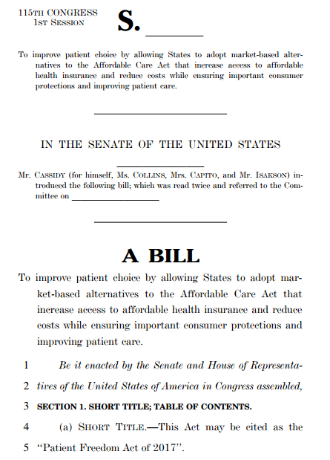
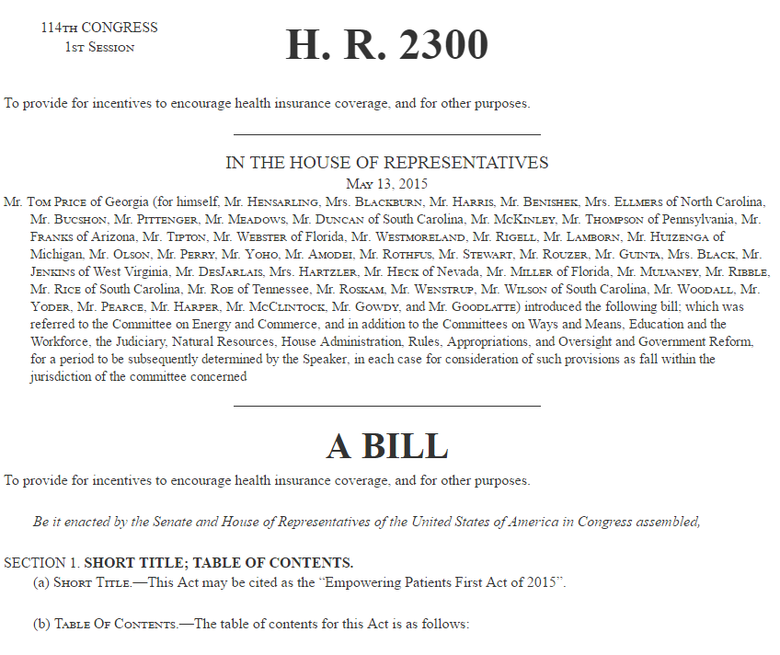
Marketplaces in ACA Replacements
Empowering Patients First Act
Tom Price, HHS Sec.
Transcending Obamacare
Avik Roy, FREOPP
Patient Freedom Act of 2017
Sen. Bill Cassidy (LA)
Sen. Susan Collins (ME)
“Health Plan and Provider Portals” provide price and quality information on plans sold in that State
Plan Portals may not directly enroll individuals in health insurance plans, Medicaid, or CHIP.
State not required to maintain a public marketplace
If state has no public marketplace, must have at least 2 private, internet-based marketplaces
States may either:
Continue using HealthCare.gov or state-based marketplace
Establish an internet-based “Transparency Portal” to compare plans
Notes:
No matter what happens with ACA, marketplaces or online “portals” likely to remain a key feature of health insurance shopping and purchasing.
Each of these and other “replacement” plans maintain premium assistance in the form of a refundable or advance premium tax credit. States would have to maintain some infrastructure for delivering this assistance to eligible individuals.
Marketplace is essentially a way to facilitate the flow of subsidies to enrollees AND shepherd them across the finish line of enrollment in one step.
However, GOP feels public exchanges are extraneous (private enterprise could fill this role) and are a vehicle for burdensome insurance regulations. Covered California’s strong active purchasing approach exemplifies this.
GOP plans, therefore, tend to make use of Health Savings Accounts for this purpose.
Price’s plan: All individuals enrolled in Health Savings Accounts; can compare plans but not complete enrollment on the Plan Portal
Roy’s plan: States could maintain a marketplace if they wanted (not clear if he means there would continue to be a federal option)
Cassidy-Collins plan: If you like your ACA, you can keep it. Other states may create their own portal for shopping but not buying.

Slide 29
Questions?

Slide 30
Thank You – Contact Information
Anna Stelter, MPH, LMSW
Health Policy Analyst
Texas Health Institute
astelter@texashealthinstitute.org
Twitter: @annajstelter

